Slide 1
Analysis of Simulation Output
Estimation Methods
Simulation Run Statstics
Replication of Runs
Elimination of Initial Bias

Slide 2
Estimation Methods
Estimates the range for the random variable so that the desired output can be achieved.
In estimation, we aim to find a range where the random variable likely lies, based on the desired outcome. For example:
Example:
Imagine a factory producing light bulbs. The lifetime of a light bulb is a random variable. Based on past data, we estimate that the lifetime of most bulbs is between 800 and 1200 hours. This range helps the factory maintain quality control and customer satisfaction.

Slide 3
Estimation Methods....cont
Infinite population has a stationary probability distribution with a finite mean µ and finite variance σ².
This assumes that the population of data is so large (infinite) that its statistical properties (mean and variance) do not change over time.
Example:
Consider tossing a fair coin. If we keep tossing it, the proportion of heads and tails approaches 50% each, no matter how many tosses. The mean (expected value) and variance of outcomes remain constant.
Mean (µ): Probability of heads or tails = 0.5.
Variance (σ²): A fixed value based on probabilities.

Slide 4
Estimation Methods....cont
Sample variable and time do not affect population distribution :
The sample we take and the time we measure it do not change the overall characteristics of the population.
Example:
The heights of adult males in a city can be represented by a population distribution. If you randomly sample people at different times of the day, the mean height of your sample will still be close to the mean height of the entire population, assuming the sampling is random.

Slide 5
Estimation Methods....cont
Variables that meet all these conditions are called independently and identically distributed (i.i.d.).
For variables to be considered i.i.d., they must be:
Independent: The outcome of one does not influence another.
Identically distributed: All variables have the same probability distribution.
Example:
Rolling a fair six-sided die multiple times:
Each roll is independent: The outcome of one roll does not affect the next.
Each roll is identically distributed: Every roll has the same probabilities (1/6 for each number).

Slide 6
Estimation Methods....cont
Central limit theorem must be invoked to rely upon normal distribution of infinite population.
The Central Limit Theorem (CLT) states that when we take a large number of samples (of sufficient size) from any population, the distribution of their means will approximate a normal distribution, even if the population itself is not normally distributed. This property allows us to use the normal distribution for estimation.
Example:
Imagine you are measuring the weights of apples in a large orchard.
The population distribution of apple weights might not be normal (it could be skewed if most apples are small but a few are very large).
However, if you randomly select a large number of samples (say, 30 apples each) and calculate the mean weight for each sample, the distribution of these sample means will approximate a normal distribution, regardless of the original distribution of weights.

Slide 7
Estimation Methods....cont
Only then we can apply estimation method to that variable taken from infinite population.
A random variable is drawn from an infinite population that has a stationary probability distribution with a finite mean (µ) and variance (σ²).
Random variables that meet all these conditions are said to be independently and identically distributed (i.i.d.).
For i.i.d. variables, the central limit theorem can be applied.
The Central Limit Theorem (CLT) states that if you add up or take the average of a large number of i.i.d. variables, their sum or average will approximate a normal distribution, even if the original variables are not normally distributed.

Slide 8
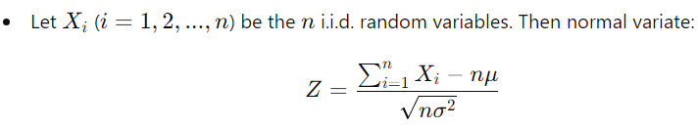
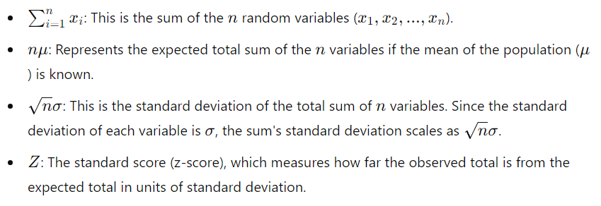
Estimation Methods....cont

Slide 9
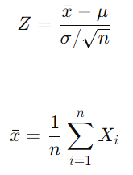
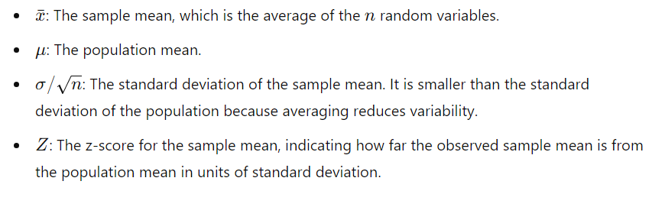
Estimation Methods....cont

Slide 10
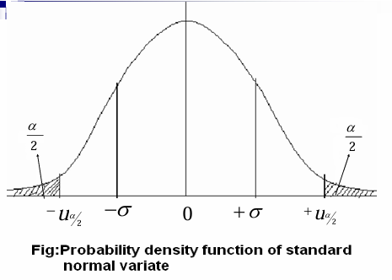

Slide 11
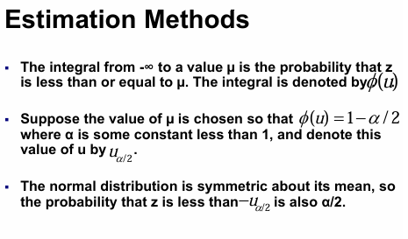

Slide 12
